Slide 1
Detecting Misinformation on Social Media using Predictive Analytics
INST414 - Spring 2025 Final Project
Carlos Lopez Vento

Slide 2
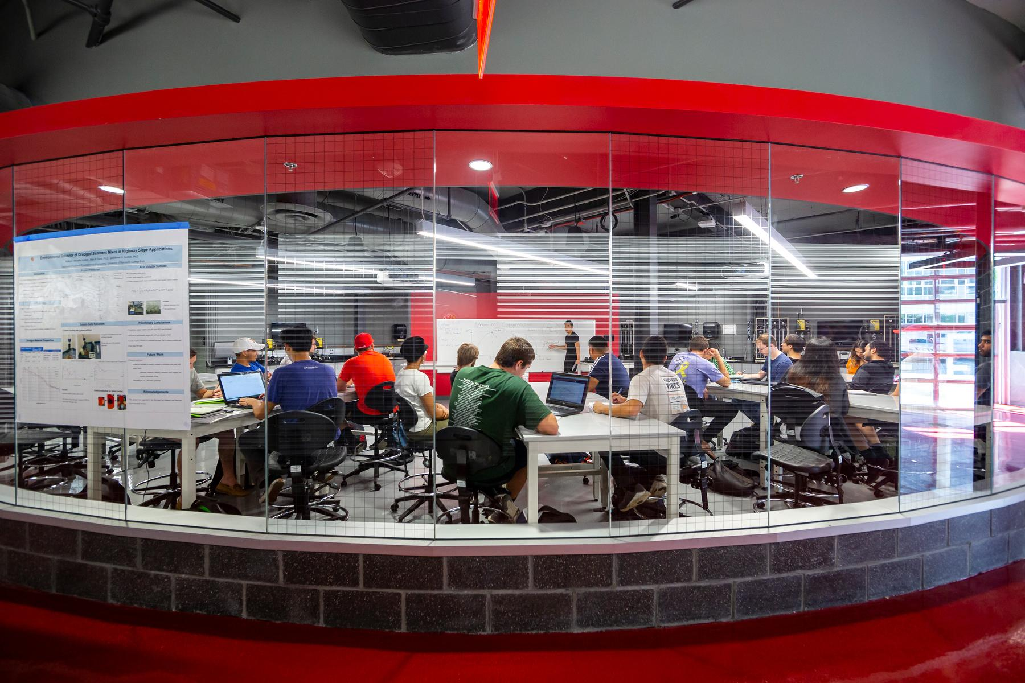
MOTIVATION
Misinformation spreads much faster than the truth, especially on platforms like Twitter/X, influencing public health, elections, and safety by eroding trust and distorting facts.
This highlights the need for automated systems that can quickly identify and prevent the spread of false information before it causes damage.

Slide 3
PROJECT OVERVIEW
This project builds a machine learning pipeline designed to detect and classify misinformation on social media, specifically on Twitter/X.
The model is trained on Kaggle’s Fake/True News dataset and tested with live tweets pulled from the Twitter API.
I used Python, Scikit-learn, XGBoost, and Tweepy for this project, applying TF-IDF for text processing. The solution was developed on Google Colab and tested using PyCharm.

Slide 4
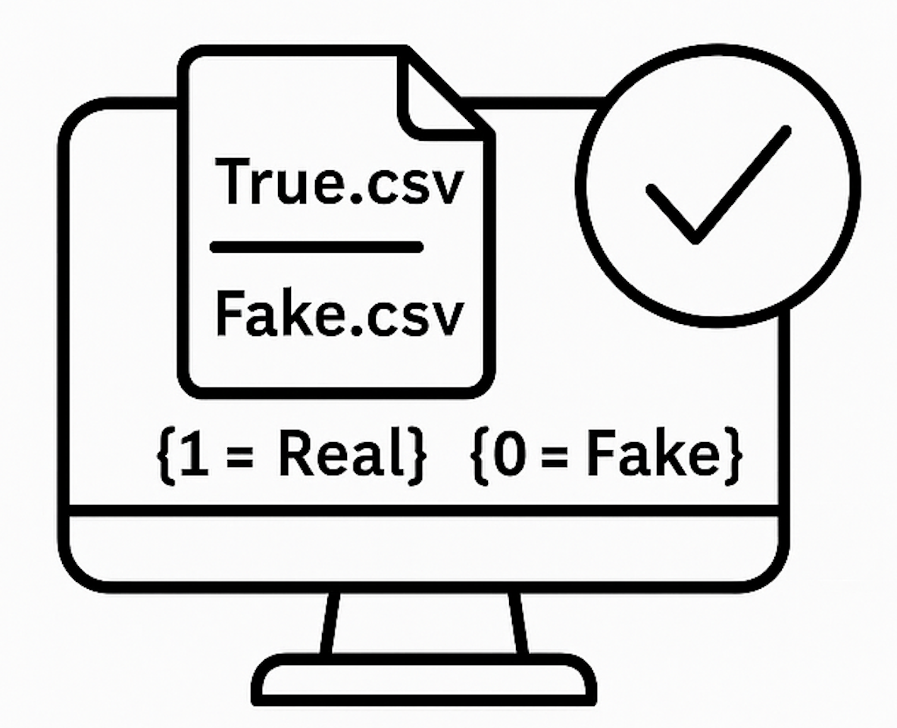
METHODOLOGY - Data Preprocessing
The data was loaded by merging Kaggle’s True.csv and Fake.csv datasets.
Data was labeled: 1 = Real, 0 = Fake.
Text preprocessing included:
Converting to lowercase
Removing punctuation
Using regular expressions to clean the tweets.

Slide 5

METHODOLOGY - Feature Engineering & Modeling
Used TF-IDF vectorization to convert text data into numerical features, selecting the top 5,000 most relevant tokens.
Models Implemented:
Logistic Regression
Random Forest
XGBoost
I used GridSearchCV to tune hyperparameters and optimize model performance

Slide 6
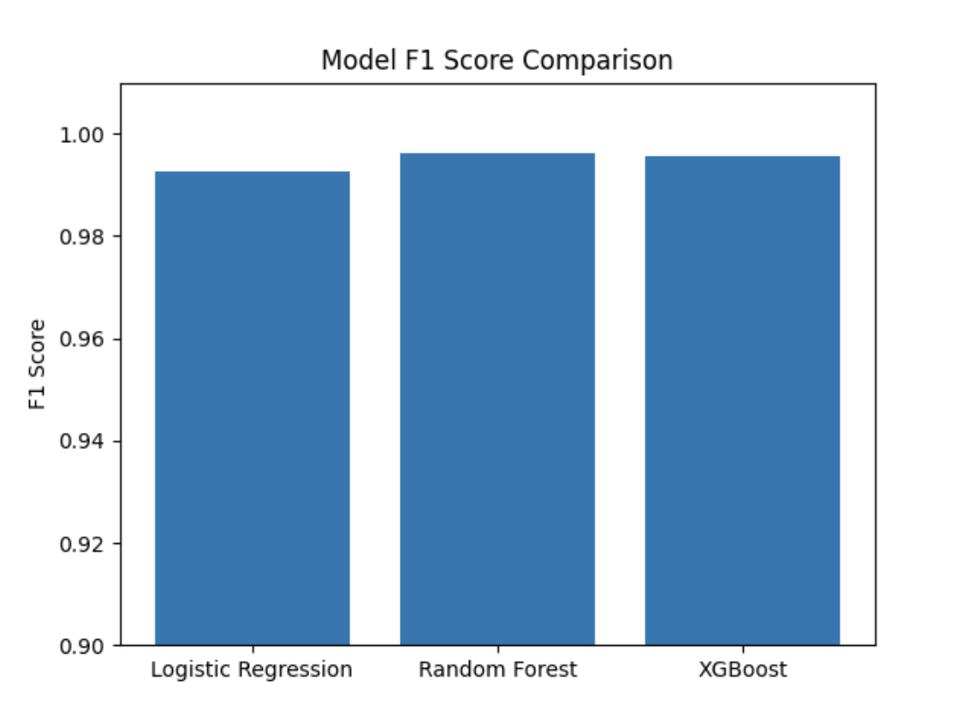
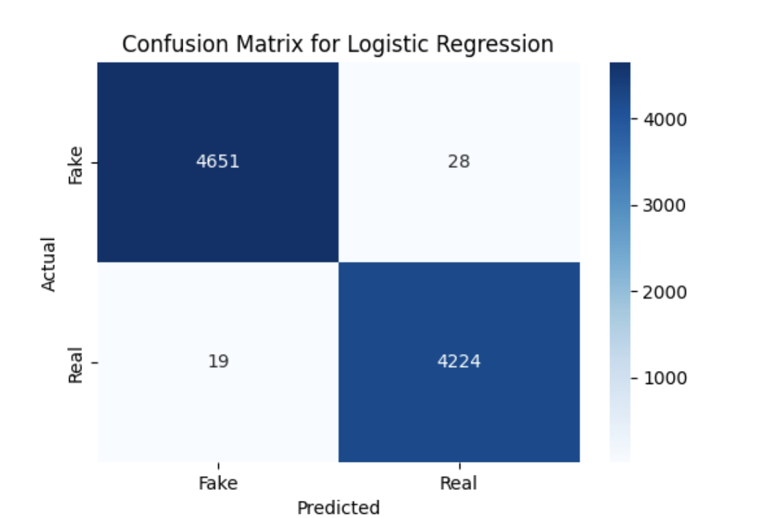
RESULTS
Best F1 Score: 0.994

Slide 7
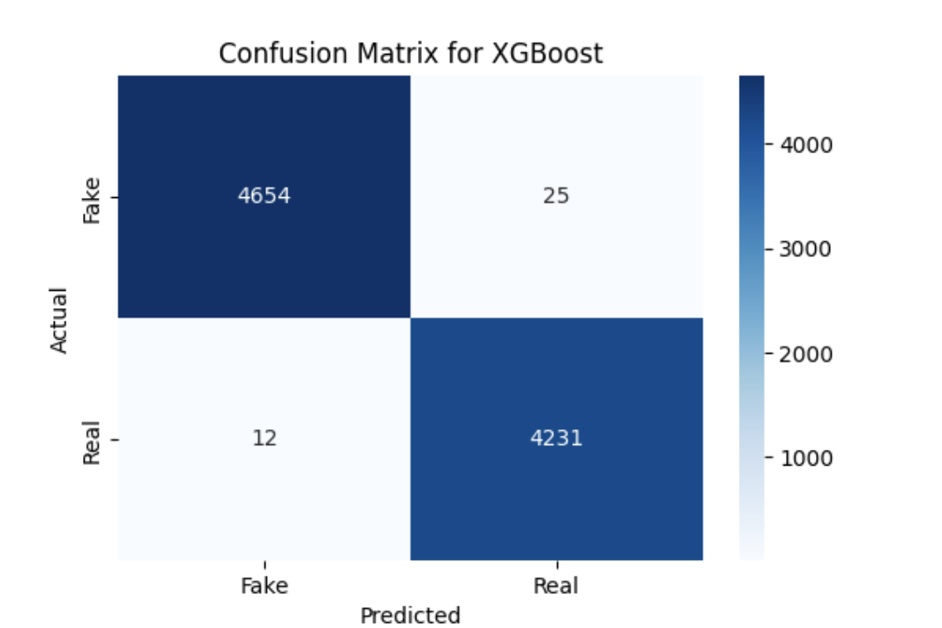

RESULTS
F1 Score: 0.995
F1 Score: 0.997

Slide 8
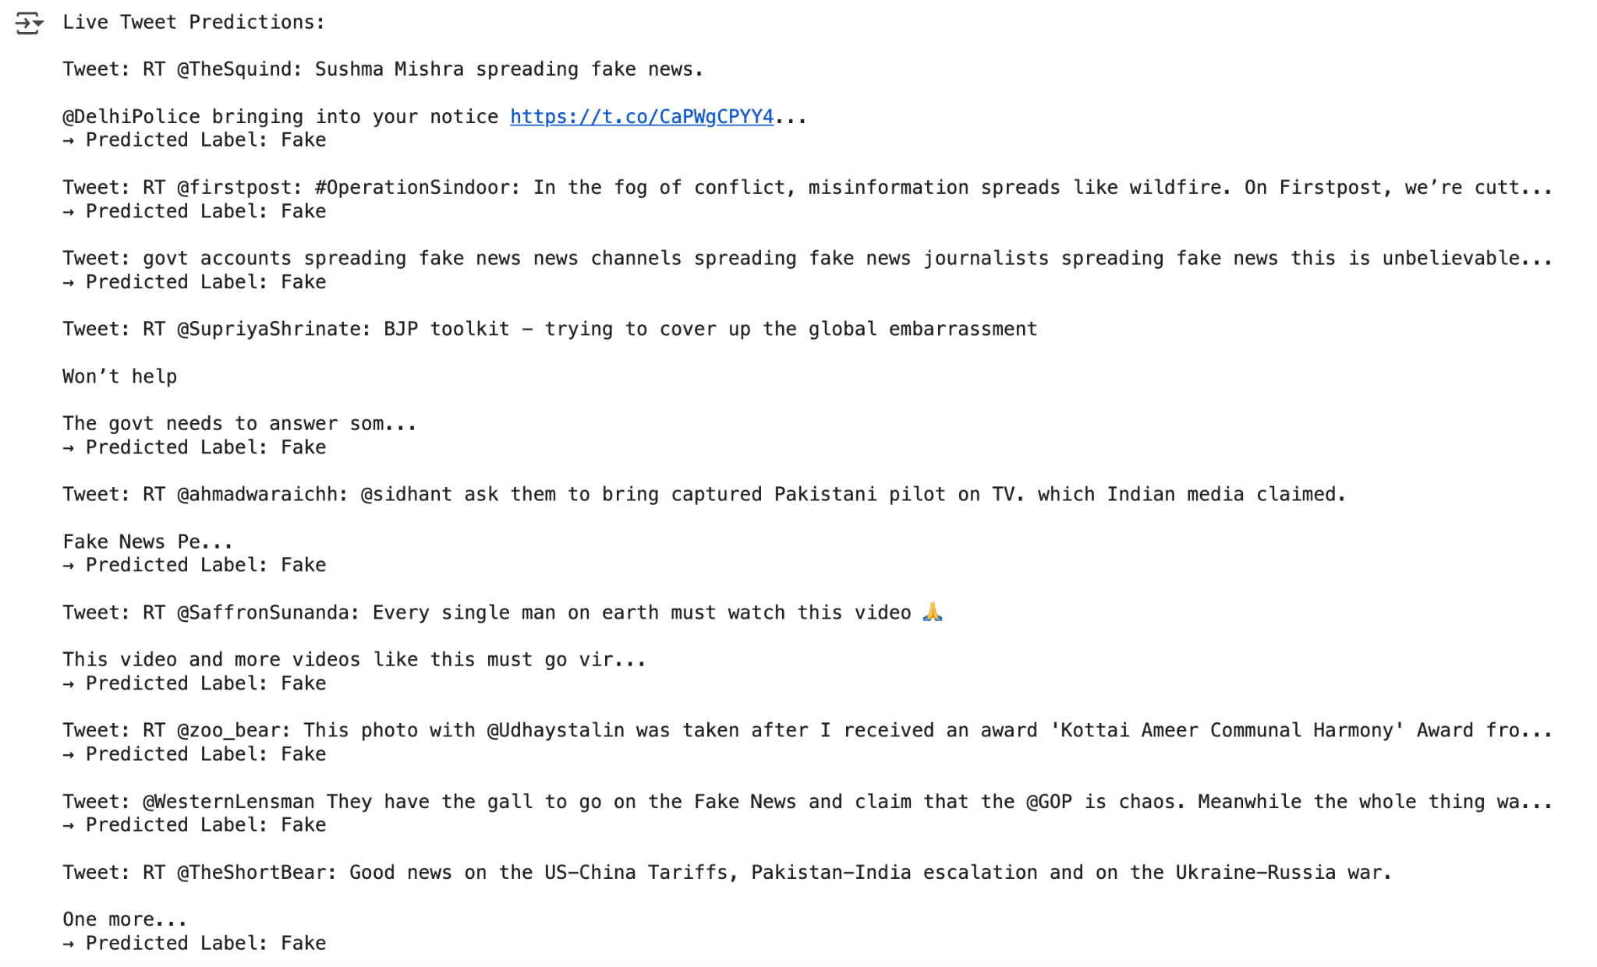
RESULTS - Live Twitter Classification
I pulled live tweets mentioning 'fake news' using the Twitter API.
The tweets were then cleaned and transformed using the same TF-IDF pipeline applied earlier in the process.
The Logistic Regression model flagged most tweets as fake, likely due to a bias towards keywords like 'fake news'.

Slide 9
IMPLICATIONS
Early detection of misinformation can assist NGOs and election boards by quickly flagging harmful content. Social platforms can leverage this system for real-time moderation, while public health agencies can act swiftly against viral misinformation.
However, dataset bias, unlabeled Twitter data, and limited domain generalization posed challenges in the project. Moving forward, it’s recommended to apply SHAP or LIME for model interpretability and expand to multilingual datasets. Better-labeled live data should also be incorporated to improve predictions.

Slide 10
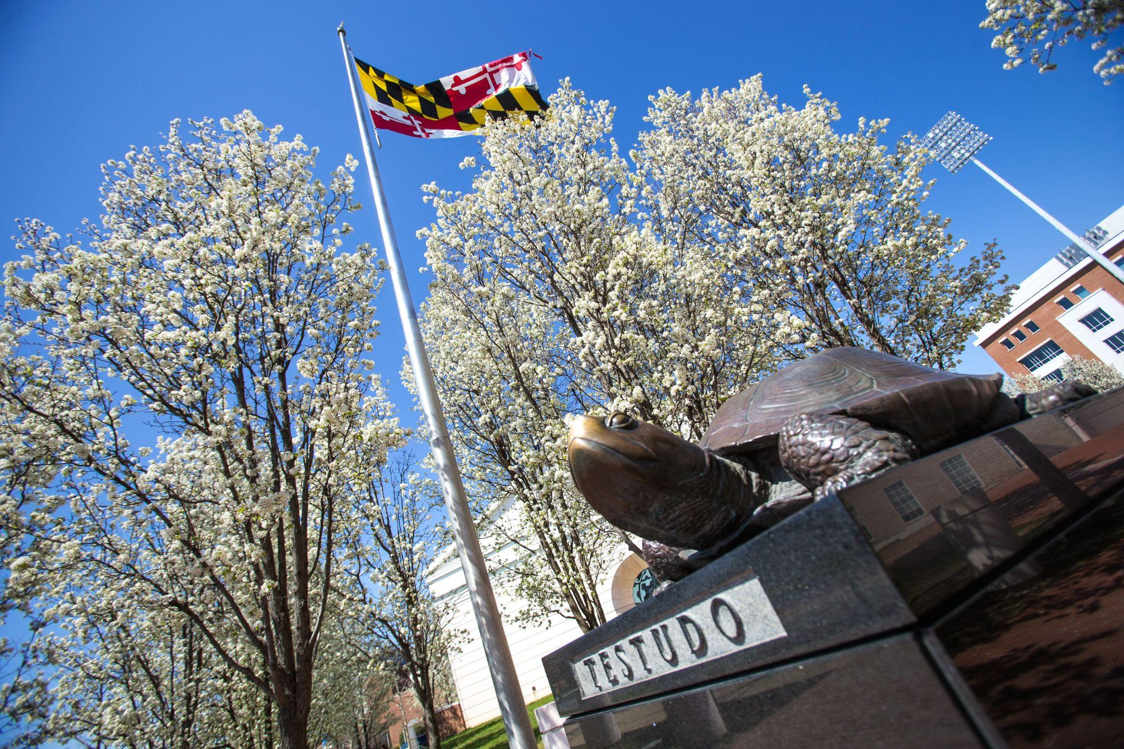
THANK YOU!

